Slide 1
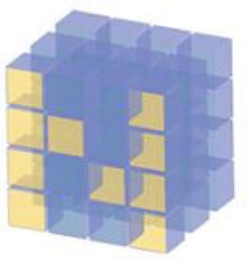
Binomial From Bernoulli

Slide 2
Reference
Youtube
Code

Slide 3
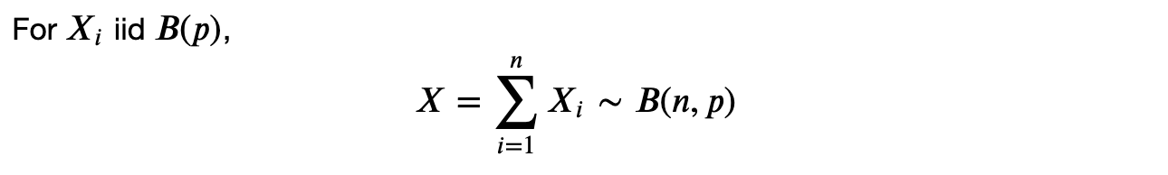

Slide 4
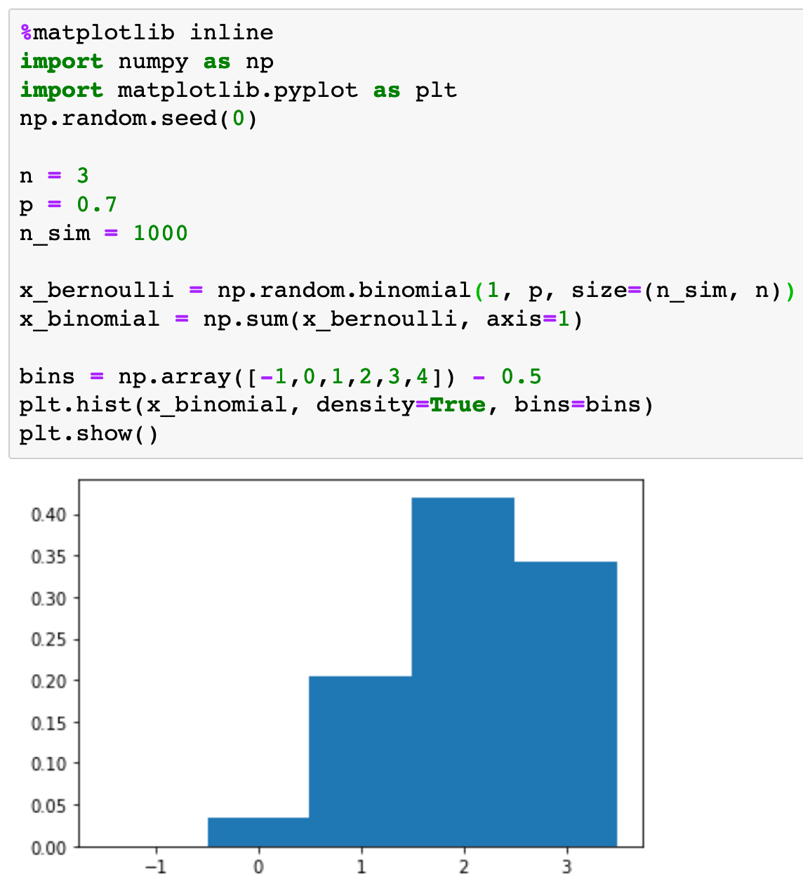

Slide 5
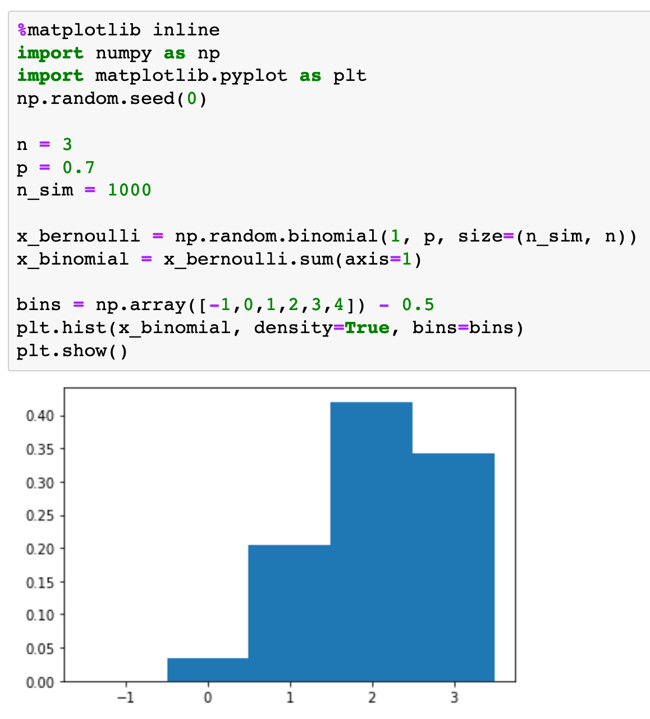

Slide 6
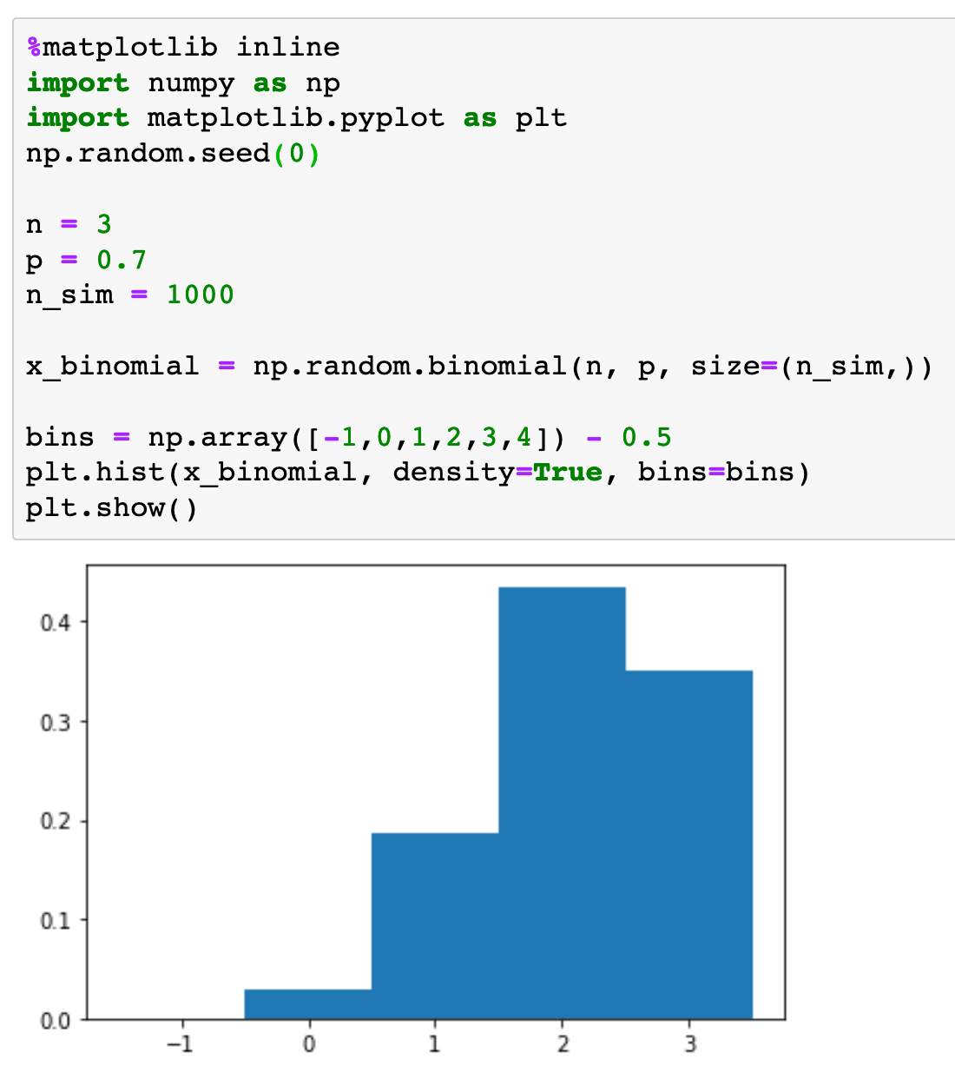

Slide 7
Exercise
Do the same simulations using scipy.stats instead of numpy.
By adding independent exponential random variables simulate gamma random variables.
By adding independent Possion random variables simulate Poisson random variables.

Slide 8
Now
Let’s Play with Code

